Slide 1
part 2
lesson 6
Functions

Slide 2
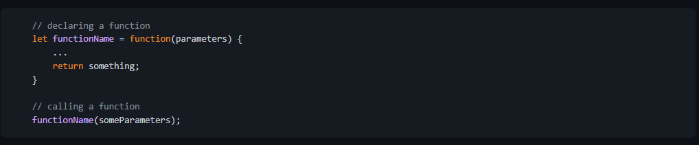
1. Declaring Functions
Javascript function is a special kind of object that is callable using () that can return value.
1. Function Expression
A function can be declared using the function keyword and assigning it to a variable. In this case, the variable name becomes the function name and is callable.
Syntax

Slide 3
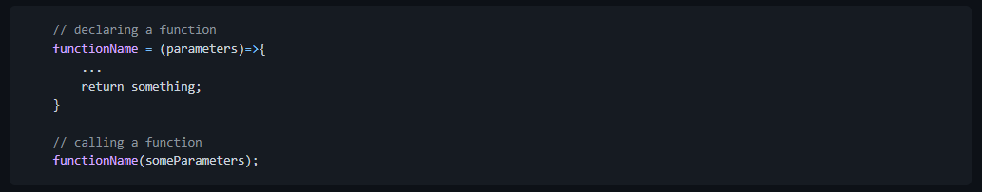
1. Declaring Functions
2. Arrow Function Syntax
This is the current preferred way to create a function. The advantage of using arrow function syntax is that it allows for creating more concise and readable code.
Syntax
1. The part of the declaration that looks like this (parameters)=>{...} is known as nameless function.
2. When a nameless function is assigned to a variable, the variable name becomes the function name.

Slide 4
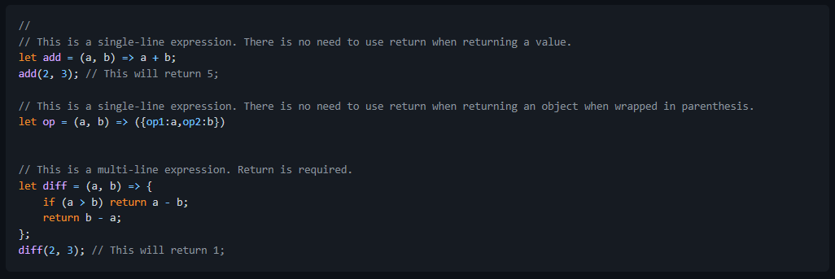
1. Declaring Functions
Example
Note: Although arrow function is preferred, not all functions can be expressed using arrow function. For example, arrow function cannot be used for creating object methods.

Slide 5
2. Auto Semi-Colon Insertion Problems
The Javascript language requires an expression to be terminated by semi-colon but the Javascript compiler historically does not enforce it.
This is because the compiler implicitly insert ; to the end of the expression using its own algorithm.
This is called auto semi-colon insertion. This lead to major quirks in the language

